Slide 1
DATA VISUALIZATION FOR LOAN APPROVAL PREDICTION DATASET
CSE 2026_DHV
Review-1
8ISE1
Roll Number | Student Name
20201ISB0019 | Siripuram Rajesh
20201ISB0023 | Chethan Kumar
20201ISB0024 | Durga Prasad T
Ms. Poornima S Ast.Professor
School of Computer Science & Engineering
Presidency University

Slide 2
Abstract
This report explores the application of data visualization techniques to the Loan Approval prediction Analysis dataset, aiming to transform raw data into actionable insights. Utilizing Python's data manipulation and visualization libraries—Pandas and Matplotlib—we present a series of visualizations that highlight the key data analysis of data. Utilizing exploratory data analysis (EDA) techniques, we visualize trends over time, identifying seasonal patterns and fluctuations across different categories. Loan approval prediction is a critical task in the financial sector, enabling institutions to assess the creditworthiness of applicants and mitigate risks effectively.
This study aims to develop a predictive model for loan approval using machine learning techniques. We employed a dataset consisting of various features such as applicant's income, credit history, employment status, loan amount, and property details. Our analysis involved data preprocessing, feature selection, and the application of multiple classification algorithms including logistic regression, decision trees, random forests, and gradient boosting. The models were evaluated using performance metrics such as accuracy, precision, recall, and the area under the ROC curve (AUC-ROC).

Slide 3
Introduction
This report provides a comprehensive analysis of Loan Approval Prediction Analysis using data visualization techniques. By leveraging Python's data manipulation and visualization libraries—Pandas, Matplotlib, and Seaborn—Machine learning offers robust solutions by leveraging historical data to identify patterns and predict outcomes, thus facilitating more informed and objective decision-making.
In the context of loan approvals, predictive models can evaluate an applicant's creditworthiness by analyzing various features such as income levels, credit history, employment status, loan amount, and property details.
The findings from this research are expected to provide valuable insights into the application of machine learning in the financial sector, offering a blueprint for enhancing loan approval processes.

Slide 4
Libraries
pandas (pd): Powerful tool for working with data tables, like spreadsheets. You can analyze, clean, and manipulate data easily.
matplotlib.pyplot (plt): Lets you create charts and graphs to visualize your data. Think colorful pictures that tell stories from numbers.
seaborn (sns): Built on top of matplotlib, seaborn makes creating attractive and informative visualizations even easier. It's like having a designer for your data charts.

Slide 5
Advantages of existing methods:
Enhanced Understanding: Visualizations convert complex data into understandable graphics, making it easier for viewers to grasp insights and trends.
Better Decision-Making: By presenting data in a visually compelling way, these techniques aid stakeholders in making informed decisions based on clear evidence.
Engagement: Visualizations are more engaging than raw data, capturing the audience's attention and facilitating deeper exploration of the data.
Communication: They improve communication of findings, making it easier to share and explain results with diverse audiences, including those without technical backgrounds.
User-Friendly: Data visualizations are often more accessible to a wider audience, including those without advanced analytical skills. They allow non-experts to understand complex datasets through intuitive graphics.
Interactivity: Many visualization tools offer interactive elements, such as zooming, filtering, and clicking to reveal more details. This interactivity makes data exploration more engaging and informative.

Slide 6
Proposed Method cont.
Tools and Libraries:
Utilized Pandas for data manipulation.
Employed Matplotlib and Seaborn for creating visualizations.
Objective:
Provided clear, insightful visualizations to understand trends, make comparisons, and visualize the pandemic's impact, aiding in informed decision-making.

Slide 7
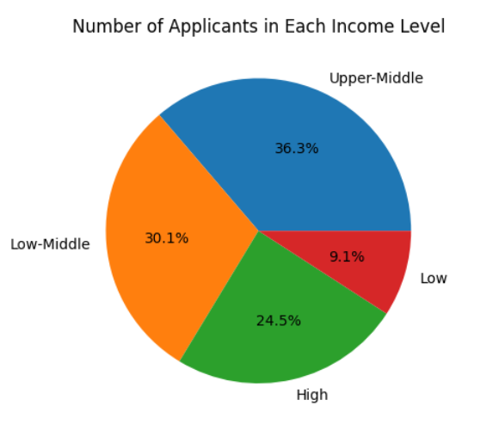
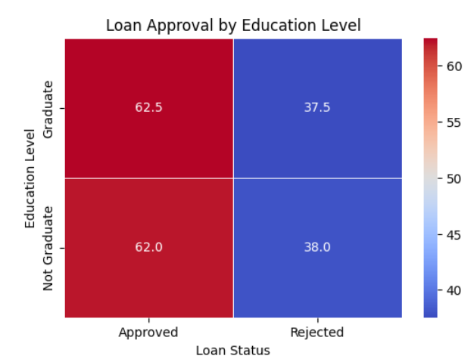
Result

Slide 8
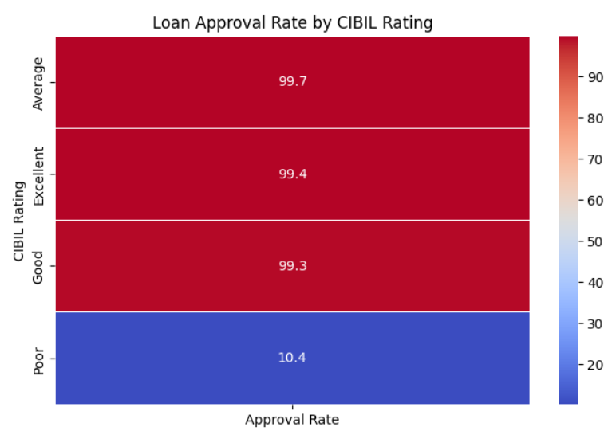
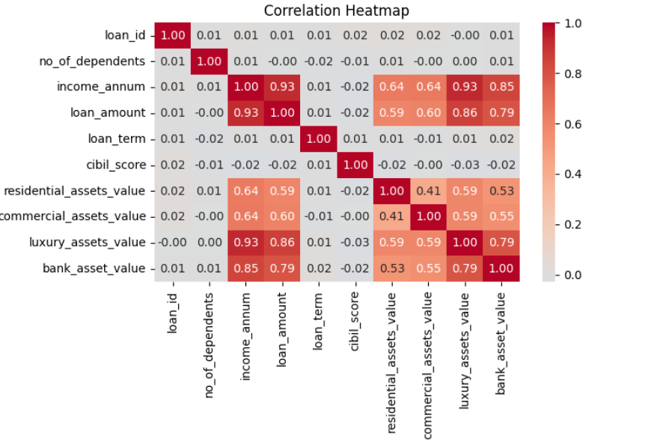
Result

Slide 9
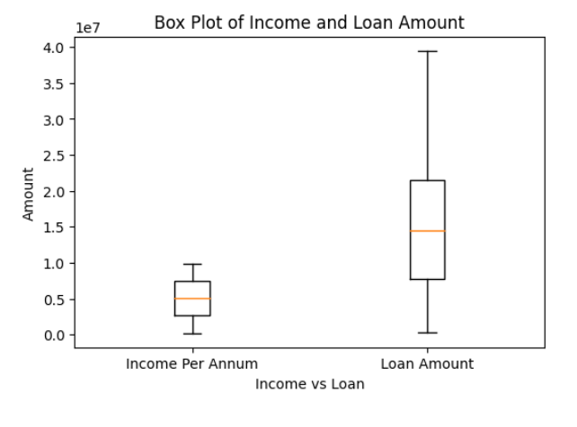
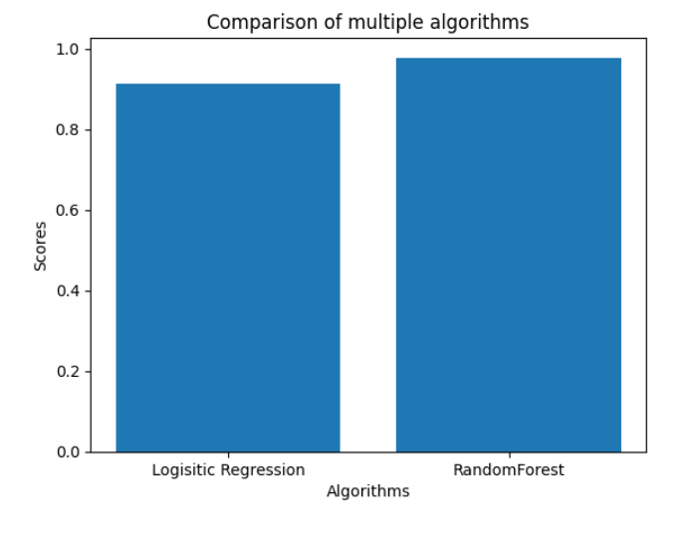
Result

Slide 10
Conclusion
Data visualization techniques act as a bridge between raw data and actionable insights. Here's how they effectively wrap up the analysis:
The implementation of machine learning techniques in loan approval prediction has shown significant promise in enhancing the decision-making process for financial institutions. Our analysis involved applying various classification algorithms, including logistic regression, decision trees, random forests, and gradient boosting, to a comprehensive dataset of loan applicants. The comparative evaluation revealed that gradient boosting outperformed other models in terms of predictive accuracy and robustness.
In conclusion, the adoption of machine learning for loan approval prediction represents a transformative approach for financial institutions. It enables more informed, data-driven decisions, ultimately leading to better risk management and more efficient credit allocation. This research provides a foundation for future developments in this area, with the potential to significantly impact the financial sector's operational paradigms.

Slide 11
Thank You

